Slide 1

New York City Airbnb Open Data
https://www.kaggle.com/dgomonov/new-york-city-airbnb-open-data

Slide 2
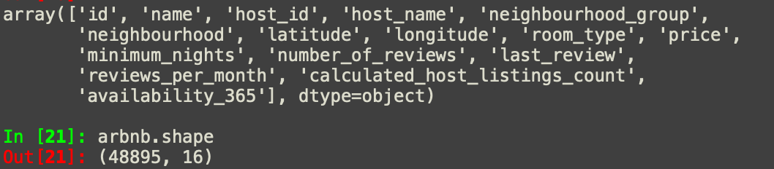
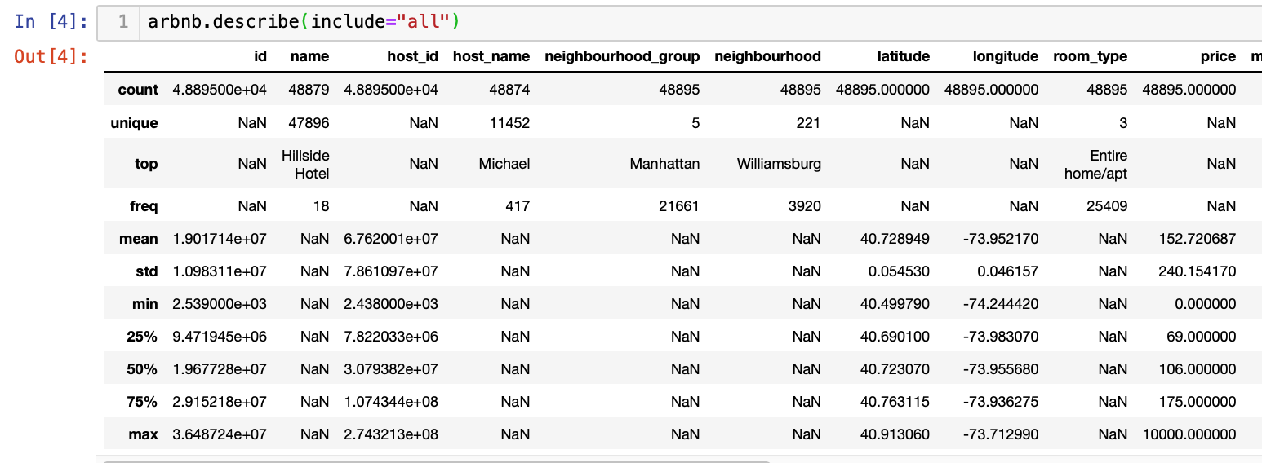
Basic Data exploration
What the first thing that we should know about dataset?

Slide 3
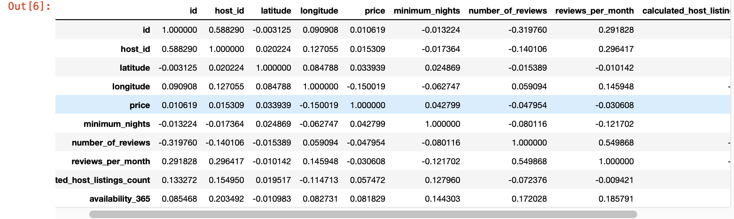
Basic Data exploration
Does features correlated with each other?

Slide 4
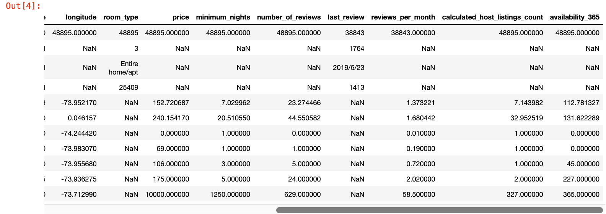
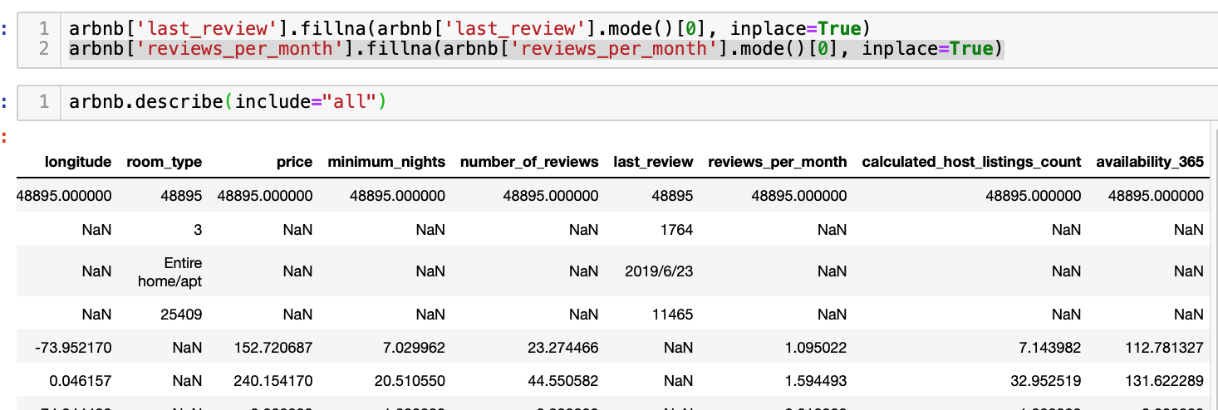
Basic Data exploration
(After filling by mode)
Any missing values?

Slide 5
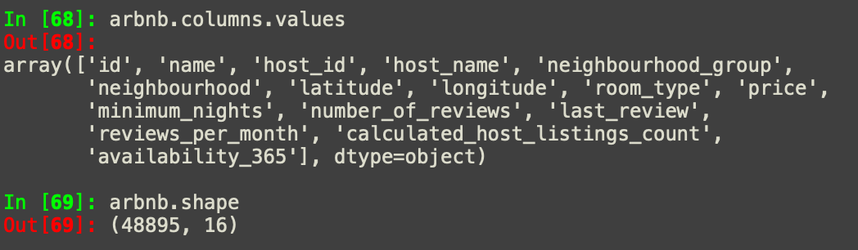
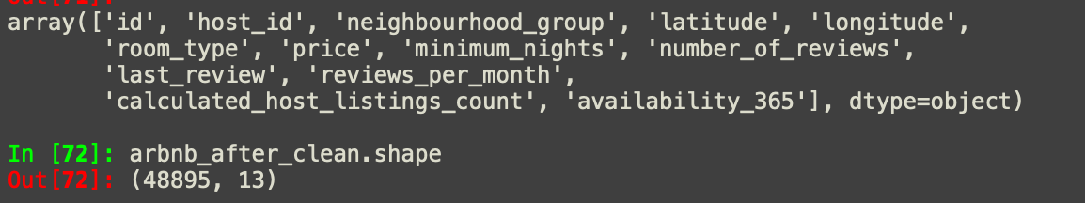
Feature engineering & data cleaning
(After cleaning dataset)
Drop unhelpful features to make prediction more accuracy and efficiency

Slide 6
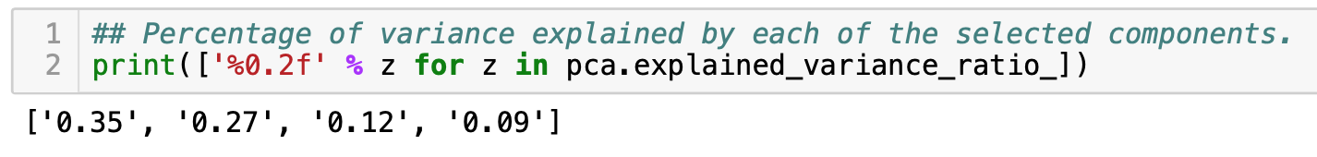
Data Mining & PCA
Since PCA does not work well for categorical data, so that we can create dummy for [﻿'neighbourhood_group’] and [﻿'room_type’] to make them as binary;
Moreover, PCA is effected by scale so we need to scale the features in the data before applying PCA
What kind of information we can get from Principal Component Analysis?

Slide 7
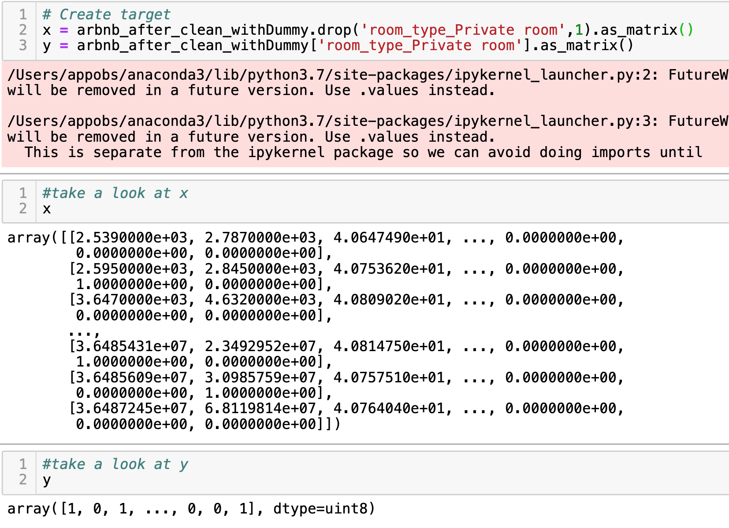
Supervised learning on [room_type]
*In term of supervised learning, we need to separate target from original dataset, in this case, I would like use supervised learning to identify the [room_type] whether it is [Private room] or not
Determine unknown records which class belongs to

Slide 8
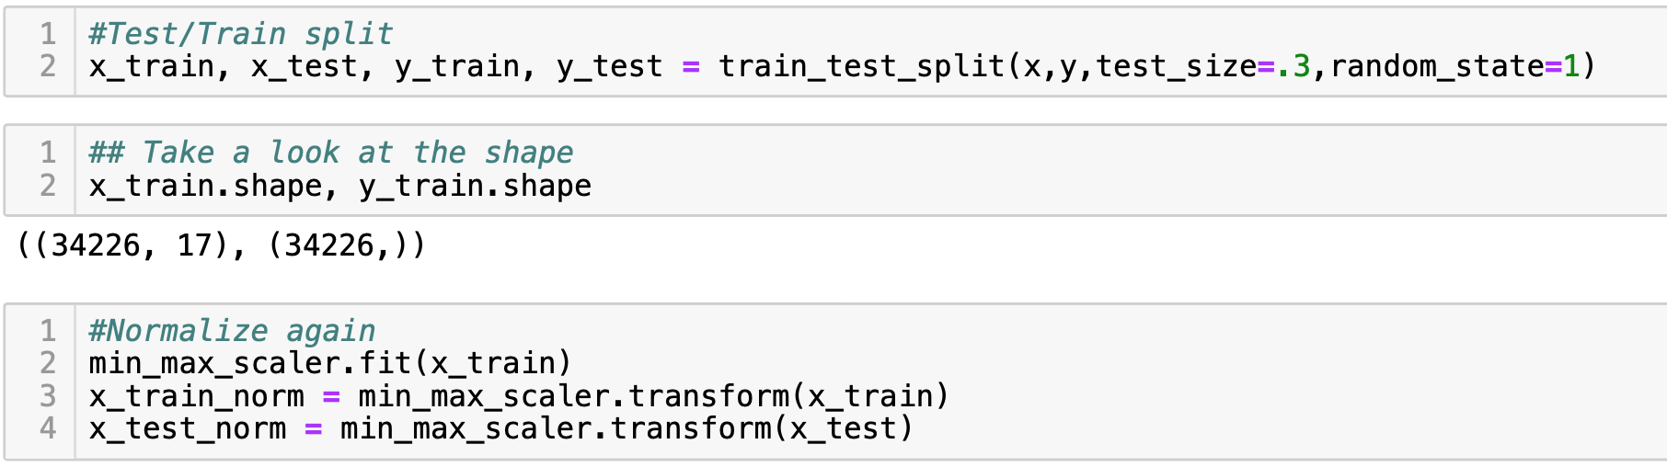
Split data set
*Before apply ML algorithm, we need to spilt dataset as training and testing. In this case, we use training set to fit model, and use testing to test performance for our model.
*Moreover, we also need to transform both train and test again before fitting model.
Training & Testing split

Slide 9
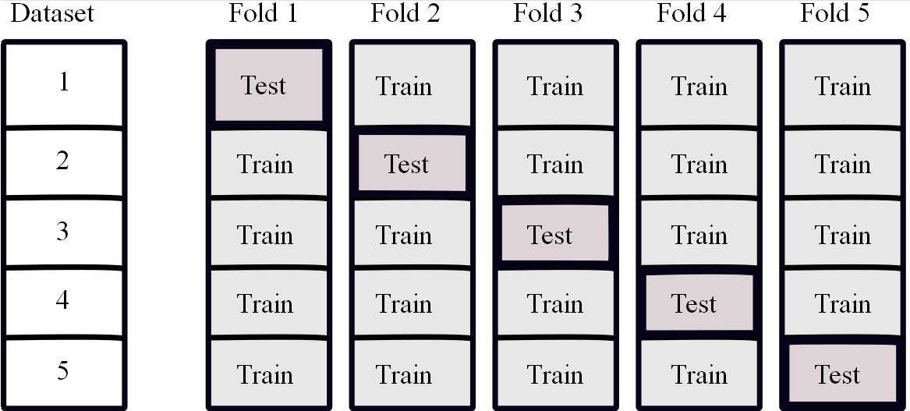
Cross Validation
How do we generalize our model to other dataset?

Slide 10
Naïve Bayes
*Bayes’s theorem plays a critical role in probabilistic learning and classification
*Uses prior probability of each class given no information about an item Classification produces a posterior probability distribution over the possible classes given a description of an item
Naïve Bayes approach

Slide 11
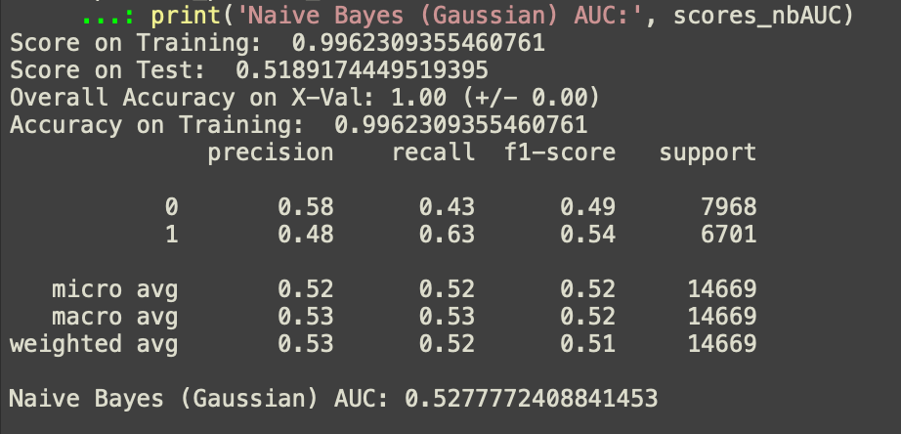
Naïve Bayes(Gaussian)
Gaussian: implements the Gaussian Naive Bayes algorithm for classification. The likelihood of the features is assumed to be Gaussian:
Does performance good?

Slide 12
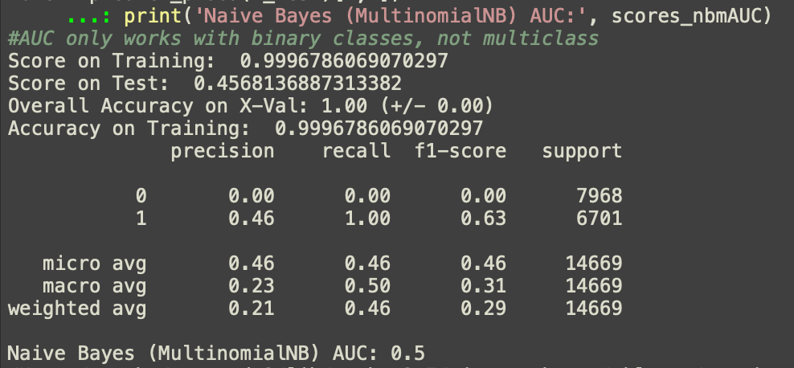
Naïve Bayes(Multinimial)
Multinimial: implements the naive Bayes algorithm for multinomially distributed data, and is one of the two classic naive Bayes variants used in text classification
Does performance good?

Slide 13
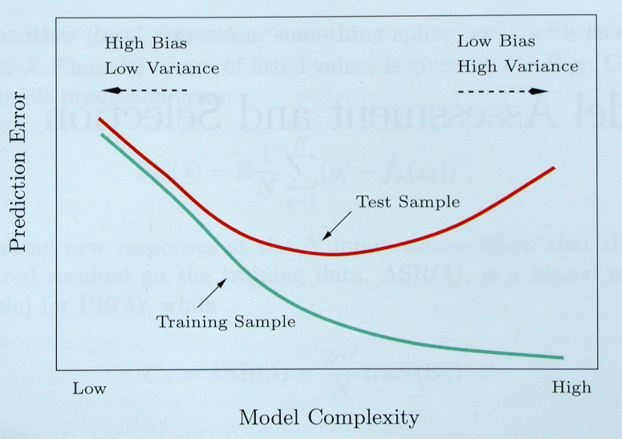
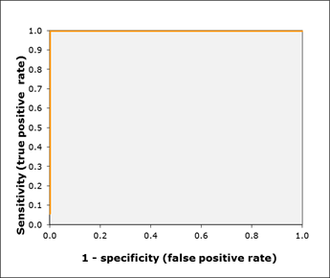
Naïve Bayes
A
Better
What we can conclude from that performance?
B
Worse
FPR =

Slide 14
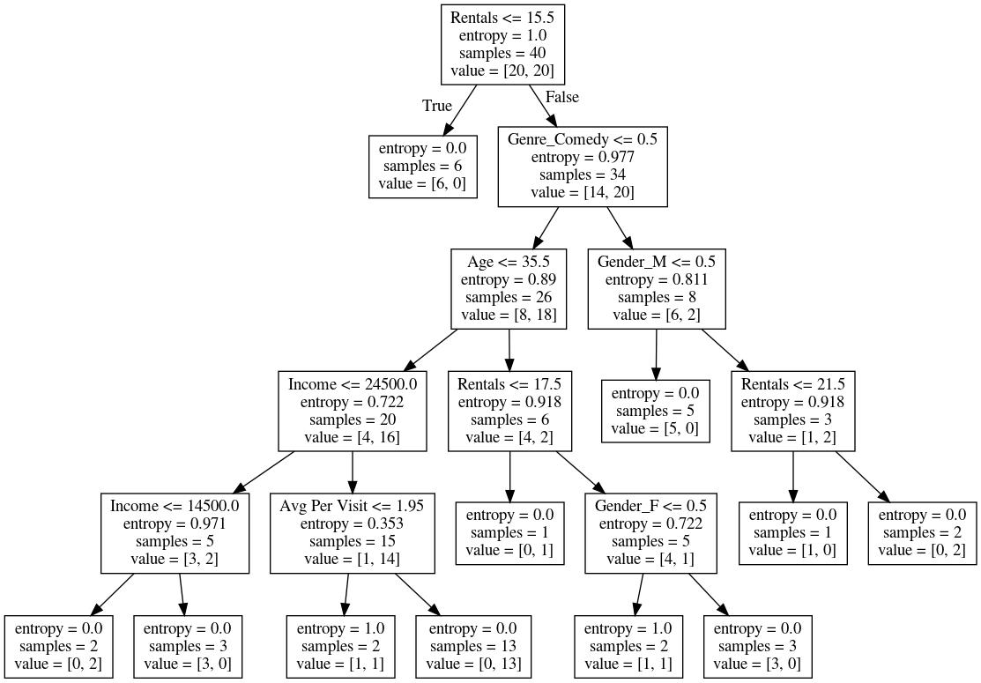
Random Forest
Random Forest is an ensemble method which combines multiple decision tree algorithms to produce repeated predictions of the same phenomenon.
(example)
Better algorithm compare with decision tree

Slide 15
Random Forest
Two basic measurement for random Forest:
Entropy:
entropy of a set on instances S is a function of the probability distribution of classes among the instances in S.
Gini index:
Introduction
A measure of impurity (based on relative frequencies of classes in a set of instances)

Slide 16
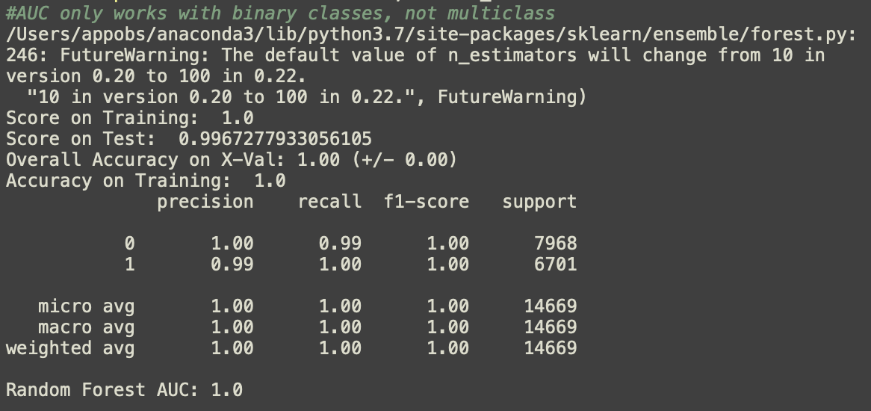
Random Forest
Results:
Both Accuracy & ROC scores suggest that model is perfect.
Perfectly! But it really happened in the real world? ?
Does performance good?

Slide 17
Performance Review
(﻿Naive Bayes (Gaussian)& (MultinomialNB)):
Random Forest Classifier:
What can we learn from these machine learning algorithms?

Slide 18
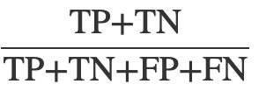
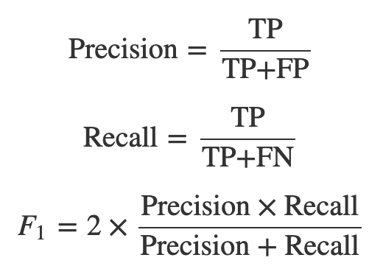
Conclusion
*Throughout the whole analysis, the random forest performed perfectly in [Airbnb open data] dataset. However, the fancy results from random forest may not reliable in real world. For instance, it possible that we overfitted in both train and test. From my point of view, the perfect results we get from random forest may because of multicollinearity
Accuracy =

Slide 19
Limitation
* More work on feature engineer
* More columns about room type

Slide 20
Future Work

